Slide 1
Mining the Pulse of Ride-Sharing Platforms: Uber vs Lyft
FA 3:Comparative Analysis and Presentation of Results

Slide 2

Introduction
Among the study's main goals :
assessment of Uber and Lyft ride statistics
to establish repeating patterns and
structural relationships and
clustering patterns.
The evaluation used
Exploratory Data Analysis as its core method together
with Association Rule Mining alongside
K-Means Clustering for principal analysis.

Slide 3
Dataset Overview
Information @ ride data that contains various essential elements.
database tracks down pricing information from the Ride Pricing category.
Ride Duration contains the period information for every single ride.
Peak Hour Demand: Variation of demand across different times.
Distance Covered: The range of rides.
During surge periods riders face increased charges because the Surge Multiplier functionality of the rides becomes activated.
Data pre-processing operations
included management of null values along with feature engineering procedures and standardization protocols.
Trade-Based Data Analysis
K-Means clustering

Slide 4
Comparative Analysis (Uber vs. Lyft)
Key Metrics Comparison
Ride Price:
The box plots show price effects resulting from different ride locations.
Multiple price factors extend further within the Uber system than within Lyft's pricing protocols.
Ride Duration & Distance:
Lyft rides normally take less time to complete than Uber rides according to scatter plot data.
Distance and price show a direct correlation which heatmaps effectively display.
Peak Hour Demand:
The day-to-day peak demand changes are depicted by line charts.
Uber intensifies its pricing system whenever customer demand reaches peak levels.
Surge Multiplier Analysis:
Relevant data on surge multiplier frequency in addition to market frequency and impact rates appears in bar charts.
Uber activates surge price tactics at higher rates than its rival Lyft does.

Slide 5
Patterns in Cab Ride Data
Surge Pricing Trends:
When both peak-time riding occurs simultaneously with poor weather conditions surge multiplier prices reach their highest levels.
The residents living near professional areas will pay higher fares for transportation during working hours.
Ride Demand by Time:
People submit multiple ride service requests throughout the morning working hours and throughout the evening work return time period.
Distance vs. Price:
Short rides cause higher price-per-mile expenses due to their fixed baseline fares.

Slide 6
Exploring the Data
Cab Ride Data (cab_ride.csv)
key ride-related details:
Column | Description
distance | Distance of the ride (miles/km).
cab type | Uber or Lyft
timestamp | Date and time of the ride
source & destination | Pickup and drop-off locations.
price | Fare amount for the ride.
surge multiplier | Price increase factor during high demand.

Slide 7
Patterns in Weather Data
Rainy Days:
The ride demand increases because most people stay indoors rather than walking in harsh weather.
Surge pricing is more common.
Extreme Temperatures (Hot/Cold):
The Uber platform experiences increased ride demand because weather conditions create both hot temperatures and cold conditions.
Windy Conditions:
Service delivery encounters small delays because weather conditions have no substantial influence on ride demand.

Slide 8
Weather Data (csv) Weather factors are included in this dataset which affect ride demand levels.
Column | Description
temp | Temperature (°C or °F)
rain | Amount of rainfall.
humidity | Moisture level in the air.
wind | Wind speed.
clouds | Cloud cover percentage.
pressure | Atmospheric pressure.
timestamp | Date and time of recorded weather
location | City or region where weather data was recorded

Slide 9
Insights from Combined Data
The comparison between datasets becomes possible when we use timestamp and location as matching fields.
Surge prices and increased demand levels occur during wet days.
Service prices increase dangerously during hours of maximum traffic density in urban areas.
Both Uber and Lyft services require extended waiting times when severe weather conditions occur.
Distance vs. Fare differences between Uber and Lyft.
Data Preprocessing Steps
To ensure accurate analysis,
we need to clean and prepare the data by handling missing values, outliers, and inconsistencies.
We will also create new useful features.

Slide 10
1. Fix Missing Data
Approach:
A method should detect null and empty fields in your columns while examining absence data.
Handling Strategies:
For numerical data (e.g., price, distance, temp):
Use mean/median imputation.
For categorical data (e.g., cab type, source, destination):
During mode imputation the most frequently observed value in the data set should become the substitution.
For missing timestamps:
When timestamp data is missing in few records the analysis should proceed without these rows unless the frequency of absence is low otherwise the surrounding entries can be utilized for timescale estimation.

Slide 11
2. Handle Outliers
Outlying data points identified as outliers produce invalid results for statistical procedures.
Steps:
The detection process for numerical column outliers within price distance and surge multiplier can be achieved through box plots analysis.
Cap or Remove Outliers:
If price > 95th percentile,
cap it at the 90th percentile.
The database requires adjustment by removing all points which extend beyond 100 miles in distance measurement.
If surge multiplier > 5,
When surge multiplier data surpasses 5 it should be replaced by the typical surge multiplier ratio found in related vehicle trips.

Slide 12
3. Standardize Data
Users need to display format consistency while they handle values during the management process.
Timestamp Standardization:
The program requires a human-readable date-time format (YYYY-MM-DD HH:MM:SS for timestamp.
Categorical Encoding:
To execute the analytic process the system requires transforming cab type along with source data and destination locations and weather status into numerical assessment values.
Price & Distance Units:
The entire distance information in the dataset requires users to measure distances by either kilometres or miles.

Slide 13
4. Feature Engineering (Creating New Features)
To improve analysis, we create new useful features from existing data
New Features in cab_ride.csv:
Feature | Description
Peak hour | 1 if ride occurs between 7-10 AM or 5-8 PM, else 0.
Ride duration category | "Short" (<5 miles), "Medium" (5-15 miles), "Long" (>15 miles)
Fare per mile | price / distance to compare Uber vs. Lyft efficiency.
weekend | 1 if ride is on a weekend, else 0.
New Features in weather.csv
Feature | Description
Weather category | "Rainy", "Clear", "Cloudy", based on rain and clouds values.
High wind | 1 if wind speed > 20 mph, else 0
Extreme temperature | 1 if temp < 5°C or > 35°C, else 0

Slide 14
Select Model
Choose an appropriate model or algorithm based on the nature of the problem, the data, desired outcome. Common techniques include decision trees, regression, clustering, classification, association rule mining, neural networks. by understanding relationship between the input features and the output prediction (explainable AI), u may use linear regression. for highly accurate prediction complex model <deep neural network> may be better.
Train Model
Train your selected model using the prepared dataset. feeding the model with the input data and adjust its parameters or weights to learn from the patterns and relationships present in the data.

Slide 15
Evaluate Model
Assess the performance and effectiveness of your trained model using a validation set or cross-validation. determine the model's accuracy, predictive power, or clustering quality and whether it meets the desired objectives. adjust the hyperparameters to prevent overfitting and improve the performance of your model.
Deploy Model
Deploy your trained model into a real-world environment it can be used to make predictions, classify new data instances, or generate insights. integrate the model into existing systems or creating a user-friendly interface for interacting with the model.

Slide 16
Monitor & Maintain Model
Continuously monitor your model's performance andensure its accuracy and relevance over time. Update the model as new data becomes available, and refine the data mining process based on feedback and changing requirements.

Slide 17
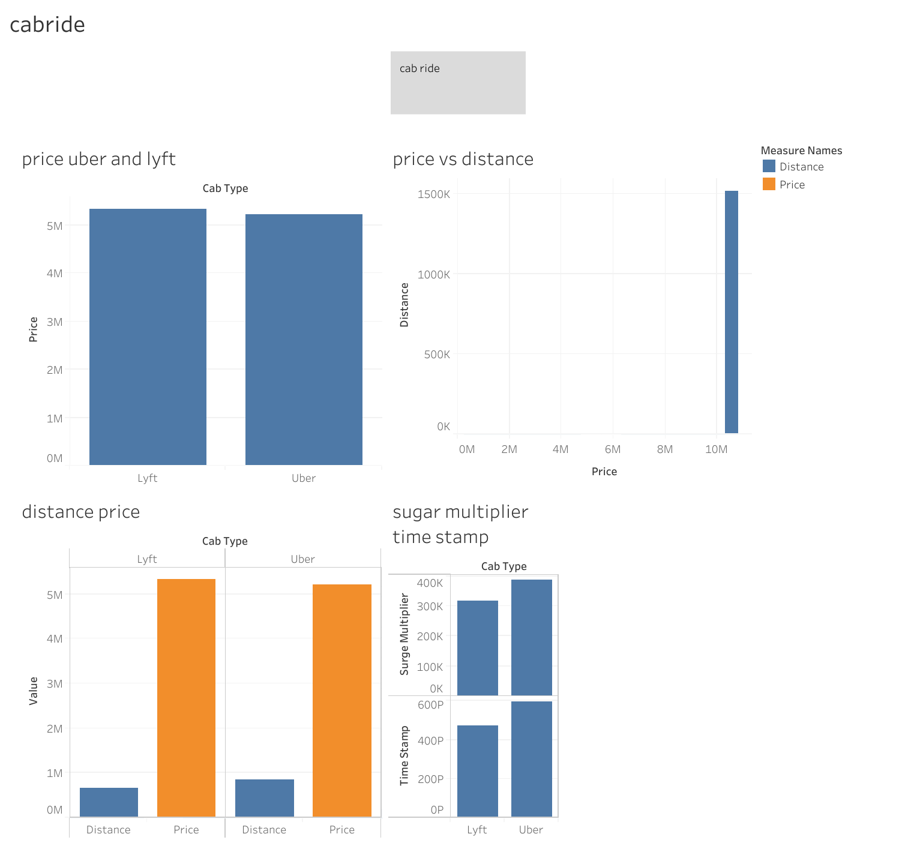
jagdis45 | Tableau Public
Edit | jagdis45

Slide 18
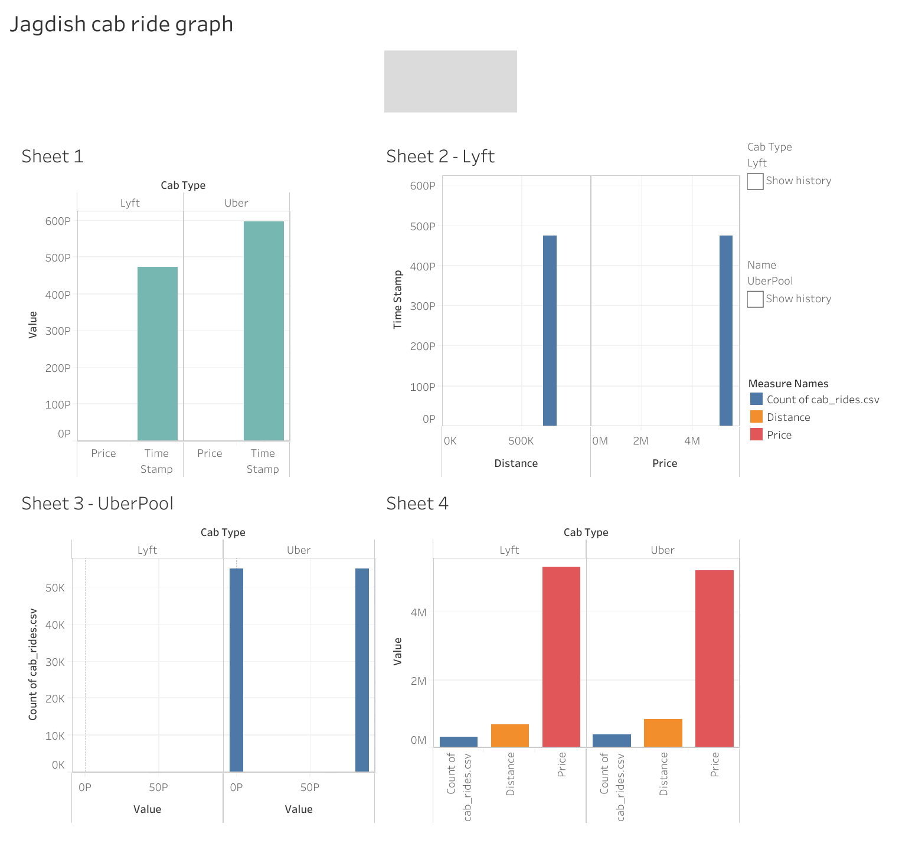
Jagdish cab graph45 | Tableau Public

Slide 19
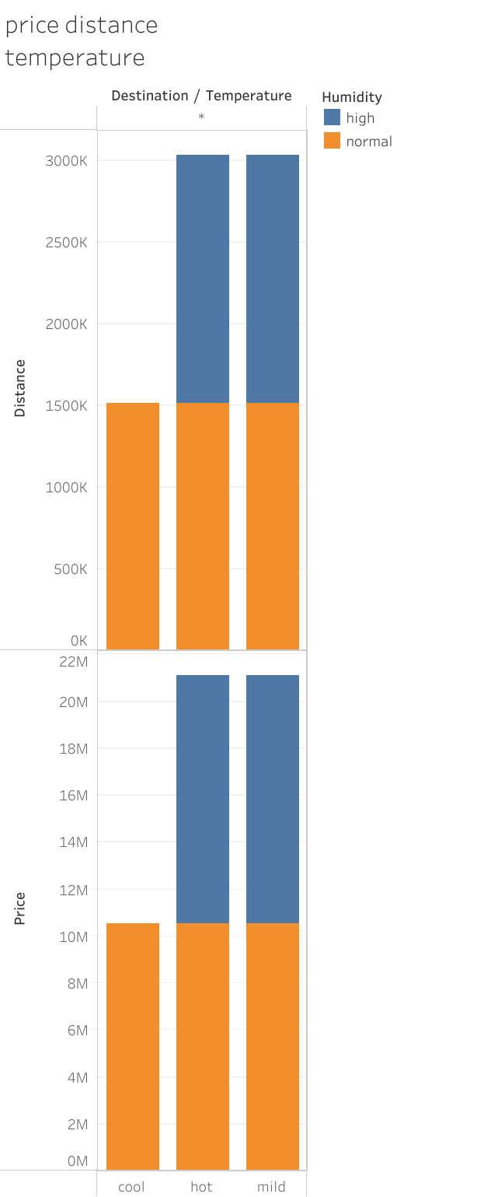

Slide 20
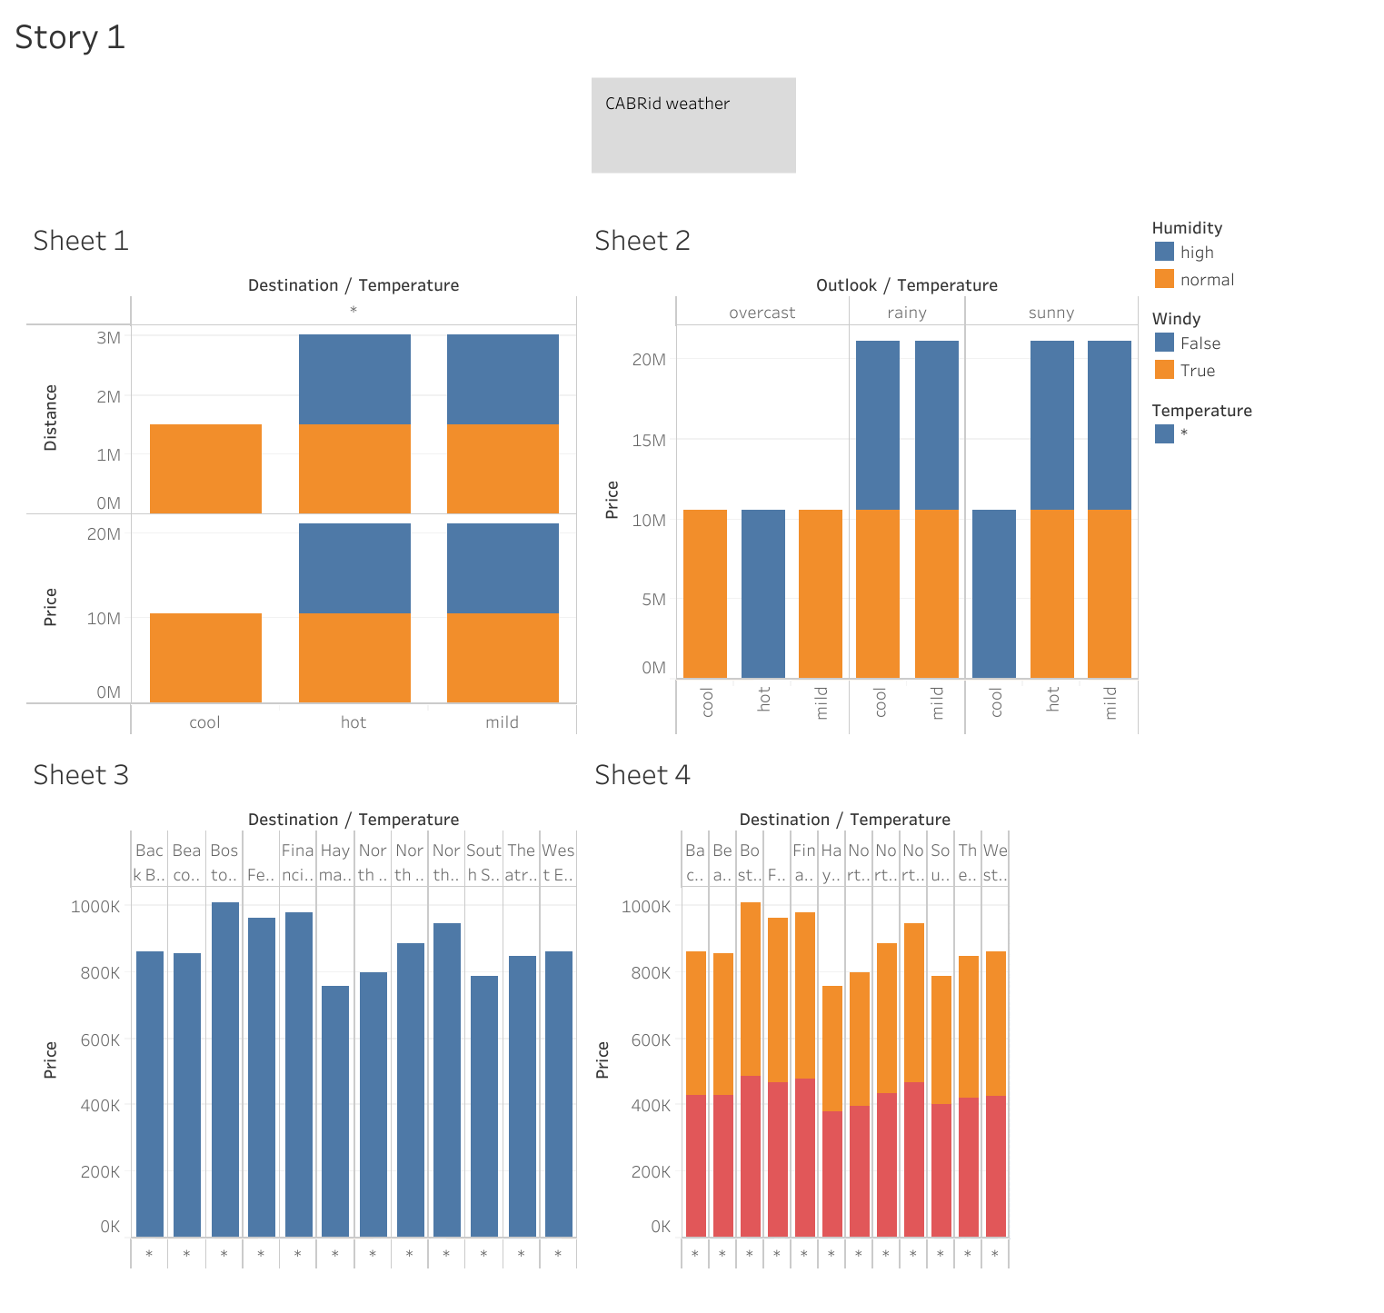

Slide 21
carride4 | Tableau Public

Slide 22
Jagdish cab graph45
LINK
File created on: 3/7/2025 4:54:50 AM
carride4 | Tableau Public

Slide 23
Problem statement Challenges Uber and Lyft face in optimizing their services
Balancing Supply and Demand
Challenge:
Ensuring there are enough drivers (supply) to meet customer ride requests (demand) at all times.
Why it’s hard:
 | Demand | Supply
Peak hours | High | Less
Off-peak hours | Less | Too many drivers
Impact: Customers may face long wait times or surge pricing, while drivers may earn less during slow periods.

Slide 24
Exploratory Data Analysis (EDA)
Key Visualizations & Findings
Ride Price & Distance Distribution
Histogram: Distribution of ride prices.
Ride fare comparison between Uber and Lyft appears through a Box Plot visual.
Density Plot: Ride distance trends.
Peak Time Analysis
The line chart tracks ride use by people across a full day period.
The bar chart displays the sharp price difference between times when ridership reaches its peak and when it remains below maximum.
Fare Comparison (Uber vs. Lyft)
The fare price variations for Uber and Lyft are represented using a box plot.
A heatmap demonstrates the relationship between ride attributes consisting of pricing information and travel distance, duration along with the surge price effect during specific times.

Slide 25
Association Rule Mining
Key Rules & Visualizations
The rideshare system expenses increase after incidents occur during peak times.
The visual heatmaps show ride associations clearly to readers.
The illustration shows how prices and ride duration and selected transportation modes connect with each other.

Slide 26
Code used in google colab
# Import necessary libraries
import pandas as pd
import numpy as np
from sklearn.preprocessing import LabelEncoder, MinMaxScaler
from sklearn.impute import SimpleImputer
from google.colab import files
import io
# Upload the dataset manually in Google Colab
print("Please upload your CSV file")
uploaded = files.upload()
# Load the dataset into a DataFrame
file_name = list(uploaded.keys())[0] # Get the uploaded file name
df = pd.read_csv(io.BytesIO(uploaded[file_name]))
# Display the initial dataset
print("\nInitial Dataset:")
print(df.head())
# Step 1: Handle Missing Values
num_features = ['total_followers', 'total_videos']
cat_features = ['country', 'category', 'location', 'trailer_title']

Slide 27
# Check if columns exist before imputing
num_features_to_impute = [f for f in num_features if f in df.columns]
cat_features_to_impute = [f for f in cat_features if f in df.columns]
# Fill missing numerical values with the median
if num_features_to_impute:
imputer_num = SimpleImputer(strategy='median')
df[num_features_to_impute] = imputer_num.fit_transform(df[num_features_to_impute])
# Fill missing categorical values with the mode
if cat_features_to_impute:
imputer_cat = SimpleImputer(strategy='most_frequent')
df[cat_features_to_impute] = imputer_cat.fit_transform(df[cat_features_to_impute])
# Drop 'picture_url' if it exists
if 'picture_url' in df.columns:
df.drop(columns=['picture_url'], inplace=True)
# Step 2: Feature Engineering (No 'joindate' to handle)
# Assume no joindate column in the dataframe
# Step 3: Encode Categorical Variables
cat_features_to_encode = [f for f in cat_features if f in df.columns]
label_encoders = {}

Slide 28
for col in cat_features_to_encode:
# Create a new LabelEncoder for each column if it hasn't been encoded yet
if col not in label_encoders:
label_encoders[col] = LabelEncoder()
df[col] = label_encoders[col].fit_transform(df[col])
# One-hot encode 'trailer_title' if it exists and hasn't been encoded yet
if 'trailer_title' in df.columns and 'trailer_title' not in label_encoders:
df = pd.get_dummies(df, columns=['trailer_title'], drop_first=True, prefix=['trailer_title'])
# Step 4: Normalize Numerical Features
num_features_to_normalize = [f for f in num_features if f in df.columns]
if num_features_to_normalize:
scaler = MinMaxScaler()
df[num_features_to_normalize] = scaler.fit_transform(df[num_features_to_normalize])
# Step 5: Final Dataset
print("\nPreprocessed Dataset:")
print(df.head())
# Save the preprocessed dataset to a CSV file
output_file_path = 'preprocessed_channel_data.csv'
df.to_csv(output_file_path, index=False)

Slide 29
# Provide download link in Colab
from google.colab import files
files.download(output_file_path)
print(f"\nPreprocessed dataset saved and ready for download: {output_file_path}")
Euclidean Distance Example: [[0. 0.66782863] [0.66782863 0. ]] Cosine Similarity Example: [[1. 0.95320821] [0.95320821 1. ]

Slide 30
# Explore the dataset
print("Data Information:")
print(data.info())
print("\nData Description:")
print(data.describe())

Slide 31

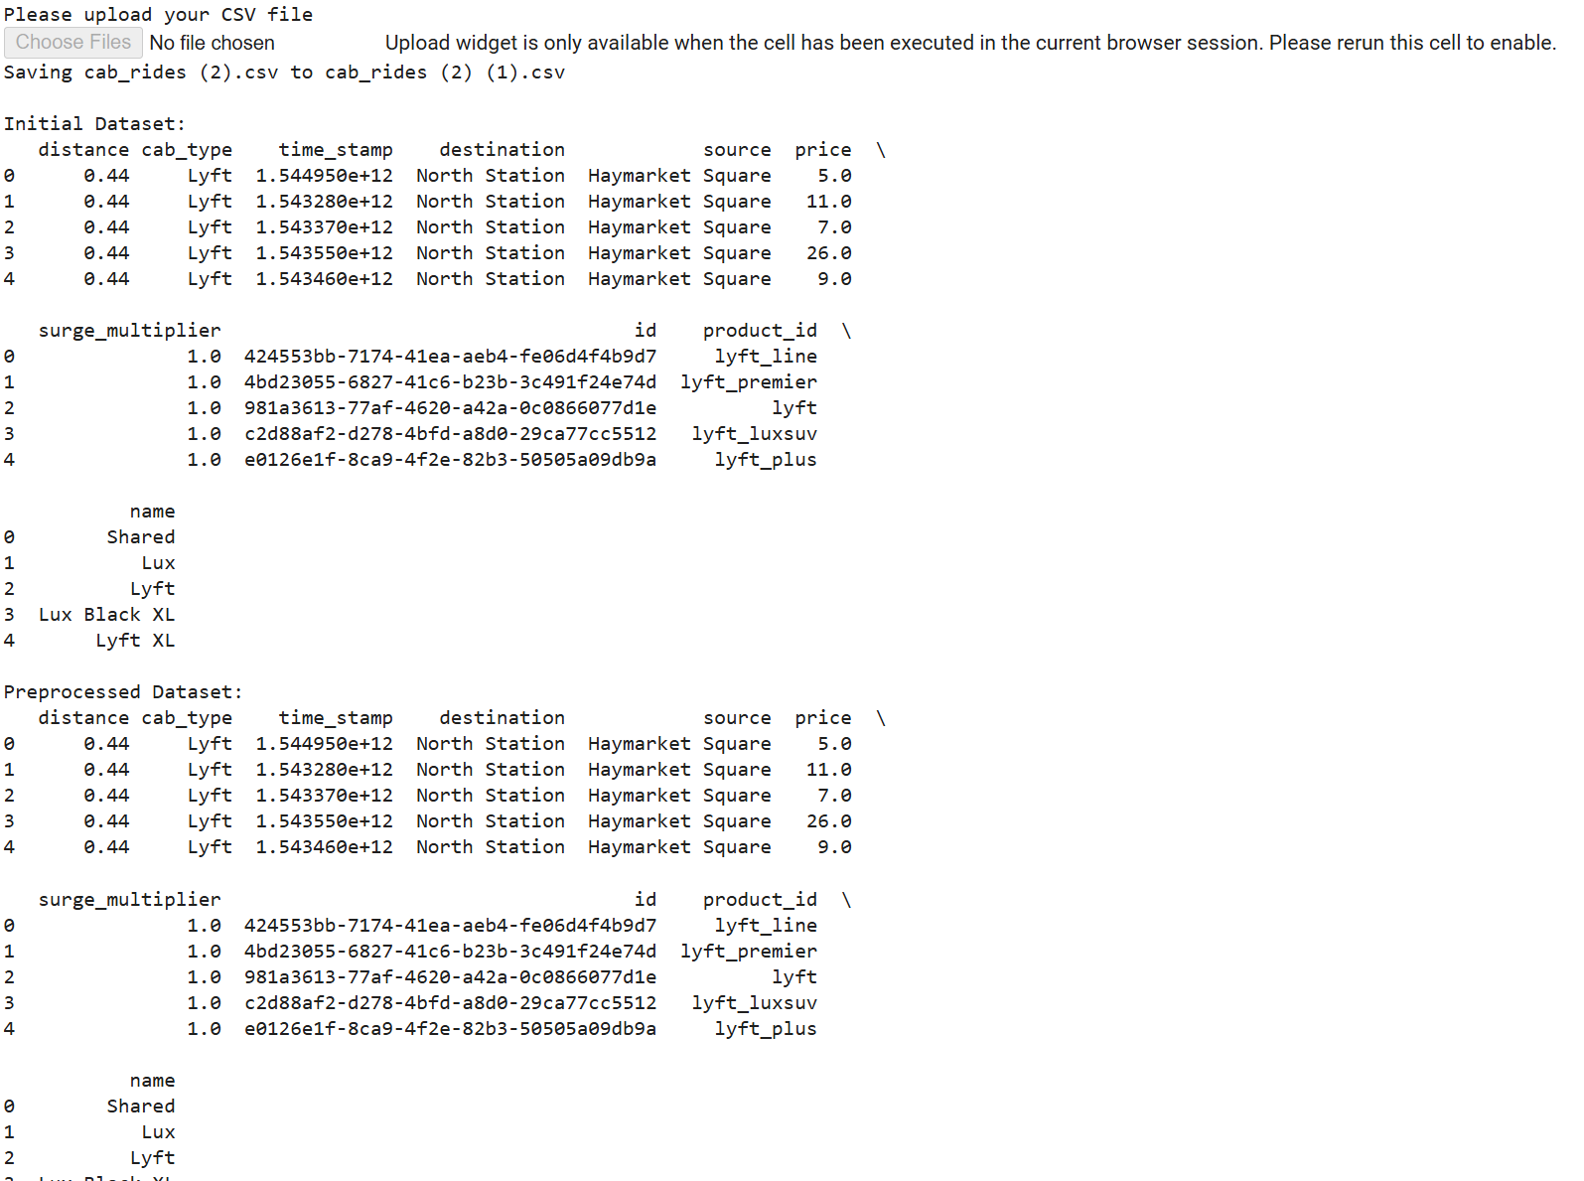
Output
Output
Encoding Categorical Features...
Handling Missing Values...
Encoding Categorical Features...
Scaling Numerical Features...
Encoding Categorical Features...
Scaling Numerical Features...

Slide 32

K-Means Clustering
Cluster Analysis & Findings
Data Preparation
Attributes Used: Price, Distance, Time.
Normalization: Ensured consistent scaling for analysis.
Clustering Process
Elbow Method Graph: Determining the optimal number of clusters.
A scatter plot techniques showcases ride clusters that signify three service groups between low-cost, premium, and peak-time services.
Cluster Insights
Cluster 1:
Low-cost, short-distance rides.
Cluster 2:
Medium-priced, mid-distance rides.
Cluster 3:
The expensive and long rides occur during peak hours.

Slide 33
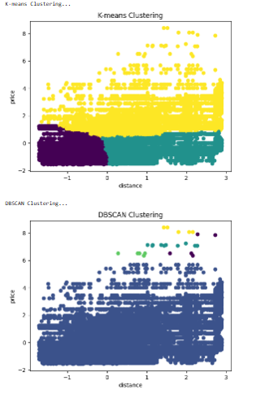

Slide 34
Classification
# --- Section 4: Classification ---
# Decision Tree Classifier
print("\nDecision Tree Classification...")
# Using "distance" as the target variable for demonstration
target = 'name'
X = data[numerical_features]
y = data[target]
X_train, X_test, y_train, y_test = train_test_split(X, y, test_size=0.2, random_state=42)
dt = DecisionTreeClassifier(max_depth=3, random_state=42)
dt.fit(X_train, y_train)
# Plot decision tree
plt.figure(figsize=(10, 8))
#plot_tree(dt, filled=True, feature_names=numerical_features, class_names=label_encoder.classes_)
class_names = label_encoder.classes_ # Assuming you've already encoded the 'name' column
plot_tree(dt, filled=True, feature_names=numerical_features, class_names=class_names)
#plot_tree(dt, filled=True, feature_names=numerical_features, class_names=['distance', 'price'])
plt.show()
# Evaluate the model
y_pred = dt.predict(X_test)
print("\nClassification Report:")
print(classification_report(y_test, y_pred))

Slide 35
Statistical testing
# --- Section 5: Statistical Testing ---
# Hypothesis Testing using t-test
print("\nHypothesis Testing...")
group1 = data[data['KMeans_Labels'] == 0]['Annual Income (k$)']
group2 = data[data['KMeans_Labels'] == 1]['Annual Income (k$)']
t_stat, p_value = ttest_ind(group1, group2)
print(f"T-statistic: {t_stat}, P-value: {p_value}")
# Conclusion based on p-value
if p_value < 0.05:
print("Statistically significant difference detected.")
else:
print("No statistically significant difference detected.")
print("\nLab Completed Successfully.")

Slide 36
Detailed Storyboard
Uber and Lyft ride statistics
to establish repeating patterns
structural relationships
clustering patterns
Key Metrics Comparison
Ride Price:
Ride Duration & Distance:
Peak Hour Demand:
Surge Multiplier Analysis:
Problem Def
Comparative Analysis
tracks down pricing information
Ride Duration.
Peak Hour Demand.
Distance Covered.
surge periods
Surge Multiplier
Dataset Overview
tracks down pricing information
Ride Duration.
Peak Hour Demand.
Distance Covered.
surge periods
Surge Multiplier
# Fill missing numerical values with the median
if num_features_to_impute:
imputer_num = SimpleImputer(strategy='median')
df[num_features_to_impute] = imputer_num.fit_transform(df[num_features_to_impute])
# Fill missing categorical values with the mode
if cat_features_to_impute:
imputer_cat = SimpleImputer(strategy='most_frequent')
df[cat_features_to_impute] = imputer_cat.fit_transform(df[cat_features_to_impute])
Pro Visuals , insights
Pre-processing

Slide 37
Links
https://colab.research.google.com/drive/1X4Iuiz0SDaYamgNBYxnkmziK4QlZreDD?usp=drive_link
https://colab.research.google.com/drive/1X4Iuiz0SDaYamgNBYxnkmziK4QlZreDD
https://colab.research.google.com/drive/1X4Iuiz0SDaYamgNBYxnkmziK4QlZreDD#scrollTo=QMQBi0GHjchp&line=16&uniqifier=1
Github link
https://github.com/JagdishKrHembrom/Data-mining-FA3.git

Slide 38
Recommendations
Through demand forecasting the system adjusts prices dynamically to optimize prices.
The business expansion should use clusters to select new customer service areas.
The organization requires improved methods to communicate surge pricing policies to its clientele.
Targeted Discounts: Attract customers during low-demand periods.

